Slide 1
Unsupervised Learning: PCA and Deep Auto-encoder
Notes:
http://www.deeplearningbook.org/contents/autoencoders.html
Output
- idea of compressions
-audoencoder
- application
retrieval
image
-also as initilization

Slide 2
Unsupervised Learning
“We expect unsupervised learning to become far more important in the longer term. Human and animal learning is largely unsupervised: we discover the structure of the world by observing it, not by being told the name of every object.” – LeCun, Bengio, Hinton, Nature 2015
Notes:
櫻桃梗

Slide 3

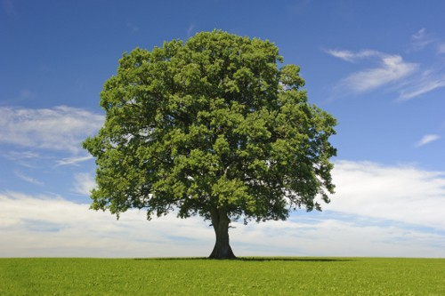
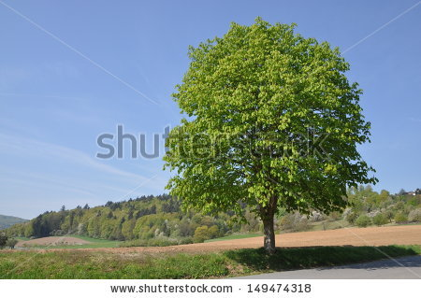
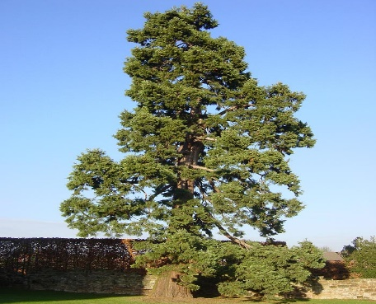
Unsupervised Learning
Clustering & Dimension Reduction
Generation
only having function input
only having function output
function
function
code
Clustering & Dimension Reduction in these slides

Slide 4



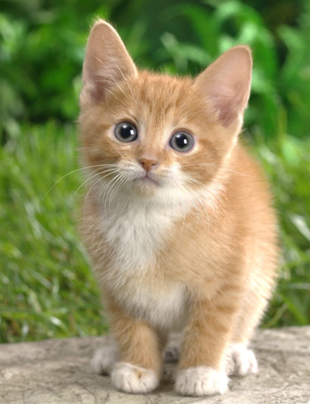
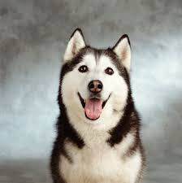


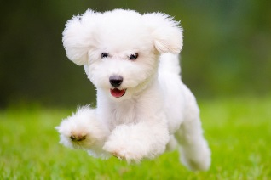
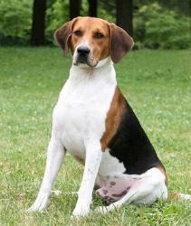
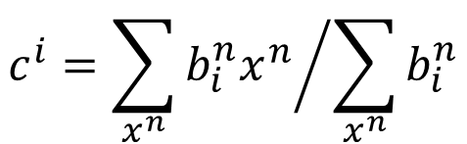
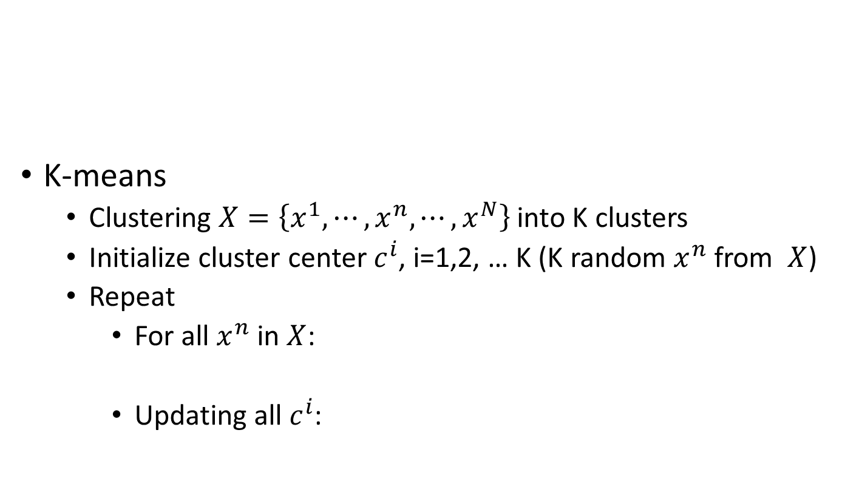
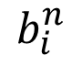
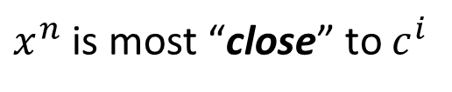
Clustering
Cluster 3
Open question: how many clusters do we need?
K-means
Clustering $X=\left\{x^{1},⋯,x^{n},⋯,x^{N}\right\}$ into K clusters
Initialize cluster center $c^{i}$, i=1,2, … K (K random $x^{n}$ from $X$)
Repeat
For all $x^{n}$ in $X$:
Updating all $c^{i}$:
Cluster 1
Cluster 2
1
$x^{n}$ is most “close” to $c^{i}$
$$b_{i}^{n}$$
0
Otherwise
$$c^{i}={\sum_{x^{n}}{b_{i}^{n}x^{n}}}/{\sum_{x^{n}}{b_{i}^{n}}}$$

Slide 5
Clustering
Hierarchical Agglomerative Clustering (HAC)
root
Step 1: build a tree
Step 2: pick a threshold
Notes:
https://www.semanticscholar.org/paper/Integrating-frame-based-and-segment-based-dynamic-Chan-Lee/7d8eaf612500420a125b3cfca98701114cf68873/pdf

Slide 6
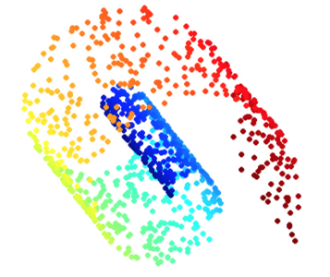
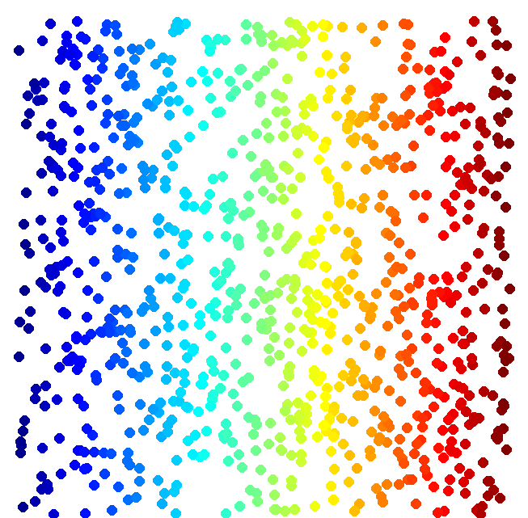
Dimension Reduction
Looks like 3-D
Actually, 2-D
http://reuter.mit.edu/blue/images/research/manifold.png
http://archive.cnx.org/resources/51a9b2052ae167db310fda5600b89badea85eae5/isomapCNXtrue1.png

Slide 7
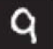
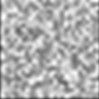
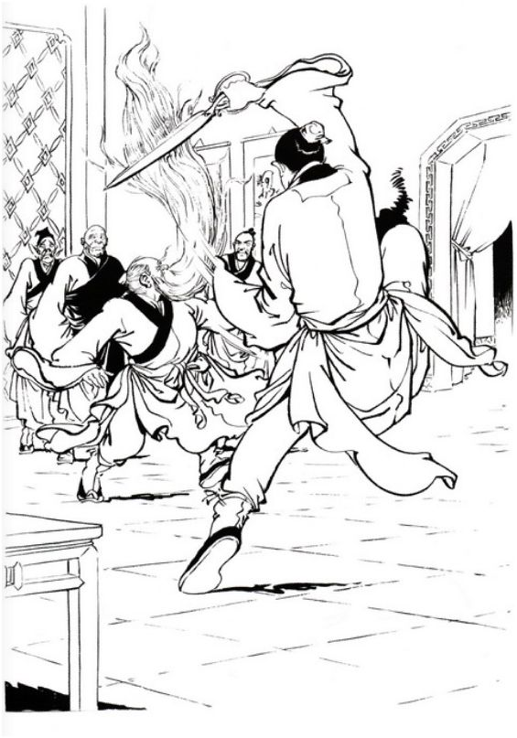
Dimension Reduction
In MNIST, a digit is 28 x 28 dims.
Most 28 x 28 dim vectors are not digits
3
3
3
3
3
-20。
-10。
0。
10。
20。
Notes:
用這個例子http://newsletter.sinica.edu.tw/file/file/4/485.pdf

Slide 8
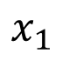
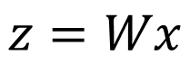
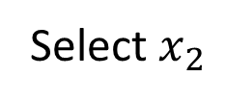
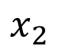
Dimension Reduction
Feature selection
Principle component analysis (PCA)
function
The dimension of z would be smaller than x
x
z
$$x_{2}$$
Select $x_{2}$
?
$$x_{1}$$
[Bishop, Chapter 12]
$$z=Wx$$

Slide 9
Principle Component Analysis (PCA)

Slide 10
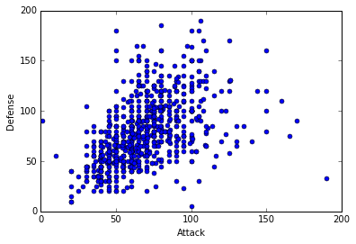
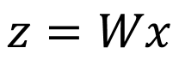
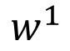
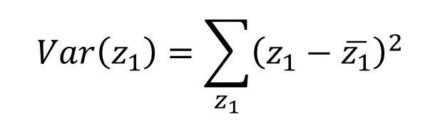

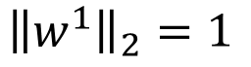
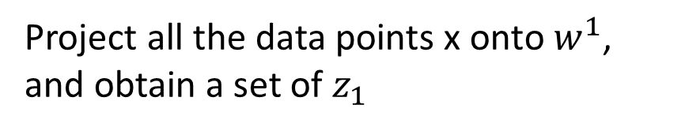
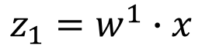
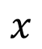
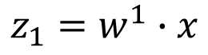
PCA
$$z=Wx$$
Large variance
Reduce to 1-D:
$$z_{1}=w^{1}∙x$$
Small variance
$$x$$
Project all the data points x onto $w^{1}$, and obtain a set of $z_{1}$
$$w^{1}$$
We want the variance of $z_{1}$ as large as possible
$$Var\left(z_{1}\right)=\sum_{z_{1}}{{\left(z_{1}−\overline{z_{1}}\right)}^{2}}$$
$$z_{1}=w^{1}∙x$$
$${\left\|w^{1}\right\|}_{2}=1$$

Slide 11
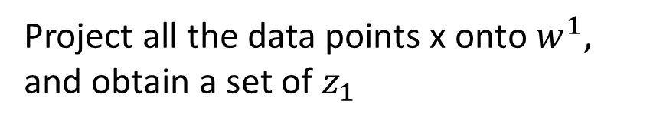
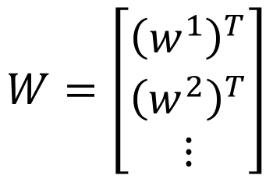
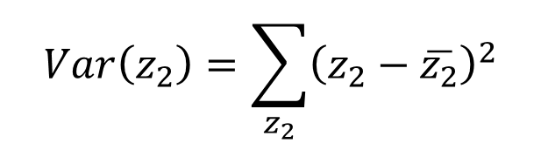
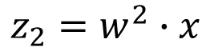

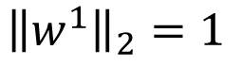
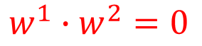
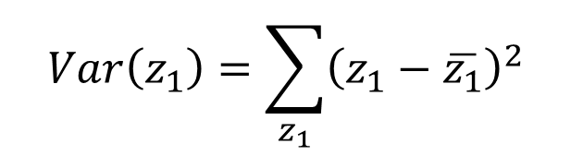
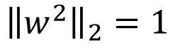

PCA
Project all the data points x onto $w^{1}$, and obtain a set of $z_{1}$
We want the variance of $z_{1}$ as large as possible
$$z=Wx$$
$$Var\left(z_{1}\right)=\sum_{z_{1}}{{\left(z_{1}−\overline{z_{1}}\right)}^{2}}$$
Reduce to 1-D:
$${\left\|w^{1}\right\|}_{2}=1$$
$$z_{1}=w^{1}∙x$$
$$z_{2}=w^{2}∙x$$
We want the variance of $z_{2}$ as large as possible
$$W=\left[\begin{aligned}{\left(w^{1}\right)}^{T} \\ {\left(w^{2}\right)}^{T} \\ ⋮\end{aligned}\right]$$
$$Var\left(z_{2}\right)=\sum_{z_{2}}{{\left(z_{2}−\overline{z_{2}}\right)}^{2}}$$
$${\left\|w^{2}\right\|}_{2}=1$$
$$w^{1}∙w^{2}=0$$
Orthogonal matrix

Slide 12
原理

Slide 13
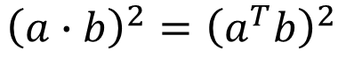
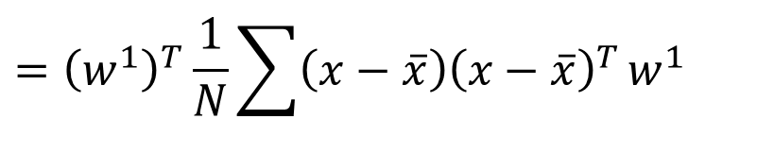
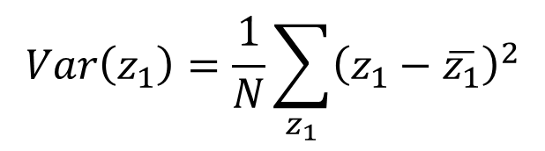
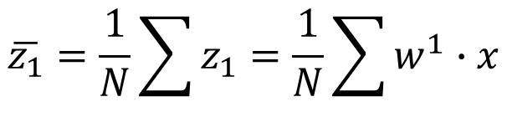
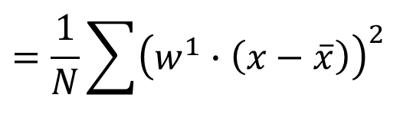
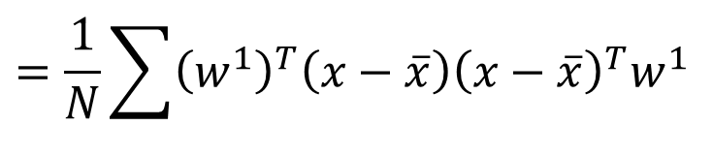
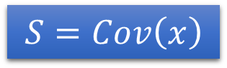
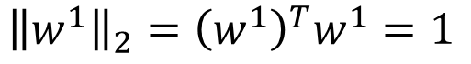
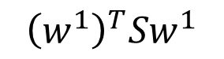
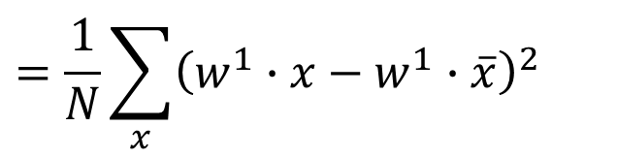
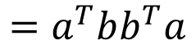


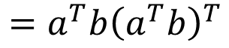
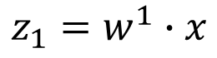



PCA
$$z_{1}=w^{1}∙x$$
$$\overline{z_{1}}=\frac{1}{N}\sum{z_{1}}=\frac{1}{N}\sum{w^{1}∙x}$$
$$=w^{1}∙\frac{1}{N}\sum{x}$$
$$=w^{1}∙\overline{x}$$
$$Var\left(z_{1}\right)=\frac{1}{N}\sum_{z_{1}}{{\left(z_{1}−\overline{z_{1}}\right)}^{2}}$$
$${\left(a∙b\right)}^{2}={\left(a^{T}b\right)}^{2}$$
$$=a^{T}ba^{T}b$$
$$=\frac{1}{N}\sum_{x}{{\left(w^{1}∙x−w^{1}∙\overline{x}\right)}^{2}}$$
$$=a^{T}b{\left(a^{T}b\right)}^{T}$$
$$=a^{T}bb^{T}a$$
$$=\frac{1}{N}\sum{{\left(w^{1}∙\left(x−\overline{x}\right)\right)}^{2}}$$
Find $w^{1}$ maximizing
$$=\frac{1}{N}\sum{{\left(w^{1}\right)}^{T}\left(x−\overline{x}\right){\left(x−\overline{x}\right)}^{T}w^{1}}$$
$${\left(w^{1}\right)}^{T}Sw^{1}$$
$$={\left(w^{1}\right)}^{T}\frac{1}{N}\sum{\left(x−\overline{x}\right){\left(x−\overline{x}\right)}^{T}}w^{1}$$
$${\left\|w^{1}\right\|}_{2}={\left(w^{1}\right)}^{T}w^{1}=1$$
$$={\left(w^{1}\right)}^{T}Cov\left(x\right)w^{1}$$
$$S=Cov\left(x\right)$$

Slide 14













Find $w^{1}$ maximizing
$${\left(w^{1}\right)}^{T}Sw^{1}$$
$${\left(w^{1}\right)}^{T}w^{1}=1$$
$$S=Cov\left(x\right)$$
Symmetric
positive-semidefinite
(non-negative eigenvalues)
Using Lagrange multiplier [Bishop, Appendix E]
$g\left(w^{1}\right)=$ ${\left(w^{1}\right)}^{T}Sw^{1}−α\left({\left(w^{1}\right)}^{T}w^{1}−1\right)$
$${∂g\left(w^{1}\right)}/{∂w_{1}^{1}=0}$$
$$Sw^{1}−αw^{1}=0$$
$${∂g\left(w^{1}\right)}/{∂w_{2}^{1}=0}$$
$$Sw^{1}=αw^{1}$$
$w^{1}$ : eigenvector
…
$${\left(w^{1}\right)}^{T}Sw^{1}=α{\left(w^{1}\right)}^{T}w^{1}$$
$$=α$$
Choose the maximum one
$w^{1}$ is the eigenvector of the covariance matrix S
Corresponding to the largest eigenvalue $λ_{1}$
Notes:
Ref: http://speech.ee.ntu.edu.tw/~tlkagk/courses/LA_2016/Lecture/special%20matrix%20(v2).ecm.mp4/index.html

Slide 15



















Find $w^{2}$ maximizing
$${\left(w^{2}\right)}^{T}Sw^{2}$$
$${\left(w^{2}\right)}^{T}w^{2}=1$$
$${\left(w^{2}\right)}^{T}w^{1}=0$$
$g\left(w^{2}\right)=$ ${\left(w^{2}\right)}^{T}Sw^{2}−α\left({\left(w^{2}\right)}^{T}w^{2}−1\right)$
$$−β\left({\left(w^{2}\right)}^{T}w^{1}−0\right)$$
$${∂g\left(w^{2}\right)}/{∂w_{1}^{2}=0}$$
$$Sw^{2}−αw^{2}−βw^{1}=0$$
0
0
1
$${\left(w^{1}\right)}^{T}Sw^{2}−α{\left(w^{1}\right)}^{T}w^{2}−β{\left(w^{1}\right)}^{T}w^{1}=0$$
$${∂g\left(w^{2}\right)}/{∂w_{2}^{2}=0}$$
$$={\left({\left(w^{1}\right)}^{T}Sw^{2}\right)}^{T}$$
$$={\left(w^{2}\right)}^{T}S^{T}w^{1}$$
…
$$={\left(w^{2}\right)}^{T}Sw^{1}$$
$$=λ_{1}{\left(w^{2}\right)}^{T}w^{1}$$
$$=0$$
$$Sw^{1}=λ_{1}w^{1}$$
$β=0$:
$$Sw^{2}−αw^{2}=0$$
$$Sw^{2}=αw^{2}$$
$w^{2}$ is the eigenvector of the covariance matrix S
Corresponding to the 2nd largest eigenvalue $λ_{2}$

Slide 16














PCA - decorrelation
$$z=Wx$$
$$z_{2}$$
$$Cov\left(z\right)=D$$
PCA
Diagonal matrix
$$z_{1}$$
$$Cov\left(z\right)=\frac{1}{N}\sum{\left(z−\overline{z}\right){\left(z−\overline{z}\right)}^{T}}$$
$$=WSW^{T}$$
$$S=Cov\left(x\right)$$
$$=WS\left[\begin{matrix}w^{1} & ⋯ & w^{K}\end{matrix}\right]$$
$$=W\left[S\begin{matrix}w^{1} & ⋯ & Sw^{K}\end{matrix}\right]$$
$$=W\left[λ_{1}\begin{matrix}w^{1} & ⋯ & λ_{K}w^{K}\end{matrix}\right]$$
$$=\left[λ_{1}\begin{matrix}{Ww}^{1} & ⋯ & λ_{K}{Ww}^{K}\end{matrix}\right]$$
$$=\left[λ_{1}\begin{matrix}e_{1} & ⋯ & λ_{K}e_{K}\end{matrix}\right]$$
$$=D$$
Diagonal matrix

Slide 17









PCA – Another Point of View
Basic Component:
1
0
1
0
1
…….
u¹
u²
u³
u⁴
u⁵
$$\left[\begin{aligned}1 \\ 0 \\ 1 \\ 0 \\ 1 \\ ⋮\end{aligned}\right]$$
1x
1x
1x
$$≈$$
+
+
u¹
u³
u⁵
$$\left[\begin{aligned}c_{1} \\ c_{2} \\ ⋮ \\ c_{K}\end{aligned}\right]$$
$$x≈c_{1}u^{1}+c_{2}u^{2}+⋯+c_{K}u^{K}+\overline{x}$$
Represent a digit image
Pixels in a digit image
component
Notes:
https://pvirie.wordpress.com/2016/03/29/linear-autoencoders-do-pca/
https://pvirie.wordpress.com/2013/10/01/pattern-covariance-analysis-of-components/

Slide 18








PCA – Another Point of View
$$x−\overline{x}≈c_{1}u^{1}+c_{2}u^{2}+⋯+c_{K}u^{K}$$
$$=\hat{x}$$
Reconstruction error:
$${\left\| (x−\overline{x})−\hat{x}\right\|}_{2}$$
Find $\left\{u^{1},…,u^{K}\right\}$ minimizing the error
$$L=\min_{\left\{u^{1},…,u^{K}\right\}}{\sum{{\left\|\left(x−\overline{x}\right)−\left(\sum_{k=1}^{K}{c_{k}u^{k}}\right)\right\|}_{2}}}$$
PCA:
$$z=Wx$$
$$\hat{x}$$
$$\left[\begin{aligned}z_{1} \\ z_{2} \\ ⋮ \\ z_{K}\end{aligned}\right]=\left[\begin{aligned}{\left(w_{1}\right)}^{T} \\ {\left(w_{2}\right)}^{T} \\ ⋮ \\ {\left(w_{K}\right)}^{T}\end{aligned}\right]x$$
$\left\{w^{1},w^{2},…w^{K}\right\}$ is the component $\left\{u^{1},u^{2},…u^{K}\right\}$ minimizing L
Proof in [Bishop, Chapter 12.1.2]

Slide 19













$$x−\overline{x}≈c_{1}u^{1}+c_{2}u^{2}+⋯+c_{K}u^{K}$$
$$=\hat{x}$$
Reconstruction error:
$${\left\| (x−\overline{x})−\hat{x}\right\|}_{2}$$
Find $\left\{u^{1},…,u^{K}\right\}$ minimizing the error
$$x^{1}−\overline{x}≈c_{1}^{1}u^{1}+c_{2}^{1}u^{2}+⋯$$
$$x^{2}−\overline{x}≈c_{1}^{2}u^{1}+c_{2}^{2}u^{2}+⋯$$
$$x^{3}−\overline{x}≈c_{1}^{3}u^{1}+c_{2}^{3}u^{2}+⋯$$
……
u¹
u²
$$c_{1}^{1}$$
$$c_{1}^{2}$$
$$c_{1}^{3}$$
…
$$≈$$
$$c_{2}^{2}$$
…
$$c_{2}^{1}$$
$$c_{2}^{3}$$
Minimize Error
…
…
…
Matrix X
Notes:
Link PCA with MDS
[1] T. Cox and M. Cox. Multidimensional Scaling. Chapman Hall, Boca Raton, 2nd edition, 2001.

Slide 20









$$x^{1}−\overline{x}$$
u¹
u²
$$c_{1}^{1}$$
$$c_{1}^{2}$$
$$c_{1}^{3}$$
…
$$≈$$
…
$$c_{2}^{1}$$
$$c_{2}^{2}$$
$$c_{2}^{3}$$
Minimize Error
…
…
…
Matrix X
M x N
M x K
K x K
K x N
X
U
∑
V
$$≈$$
K columns of U: a set of orthonormal eigen vectors corresponding to the k largest eigenvalues of XX^{T}
This is the solution of PCA
SVD:
http://speech.ee.ntu.edu.tw/~tlkagk/courses/LA_2016/Lecture/SVD.pdf

Slide 21















PCA looks like a neural network with one hidden layer (linear activation function)
Autoencoder
If $\left\{w^{1},w^{2},…w^{K}\right\}$ is the component $\left\{u^{1},u^{2},…u^{K}\right\}$
$$\hat{x}=\sum_{k=1}^{K}{c_{k}w^{k}}$$
To minimize reconstruction error:
$$x−\overline{x}$$
$$c_{k}=\left(x−\overline{x}\right)∙w^{k}$$
$K=2$:
$$w_{1}^{1}$$
$$w_{1}^{1}$$
$${\hat{x}}_{1}$$
$$c_{1}$$
$$w_{2}^{1}$$
$$w_{2}^{1}$$
$$x−\overline{x}$$
$${\hat{x}}_{2}$$
$$w_{3}^{1}$$
$$w_{3}^{1}$$
$${\hat{x}}_{3}$$
Notes:
$$K=2$$

Slide 22









PCA looks like a neural network with one hidden layer (linear activation function)
Autoencoder
If $\left\{w^{1},w^{2},…w^{K}\right\}$ is the component $\left\{u^{1},u^{2},…u^{K}\right\}$
$$\hat{x}=\sum_{k=1}^{K}{c_{k}w^{k}}$$
To minimize reconstruction error:
$$x−\overline{x}$$
$$c_{k}=\left(x−\overline{x}\right)∙w^{k}$$
$K=2$:
It can be deep.
Deep Autoencoder
$${\hat{x}}_{1}$$
$$c_{1}$$
Minimize error
$$w_{1}^{2}$$
$$x−\overline{x}$$
$${\hat{x}}_{2}$$
$$x−\overline{x}$$
$$w_{1}^{2}$$
$$c_{2}$$
$$w_{2}^{2}$$
$$w_{2}^{2}$$
Gradient Descent?
$$w_{3}^{2}$$
$${\hat{x}}_{3}$$
$$w_{3}^{2}$$
Notes:
$$K=2$$

Slide 23


Weakness of PCA
Unsupervised
Linear
PCA
Non-linear dimension reduction in the following lectures
LDA
http://www.astroml.org/book_figures/chapter7/fig_S_manifold_PCA.html

Slide 24


PCA - MNIST
$$=a_{1}w^{1}+a_{2}w^{2}+⋯$$
images
30 components:
Eigen-digits

Slide 25


PCA - Face
30 components:
http://www.cs.unc.edu/~lazebnik/research/spring08/assignment3.html
Eigen-face
Notes:
Example of an original image of ORL face database

Slide 26


What happens to PCA?
$$=a_{1}w^{1}+a_{2}w^{2}+⋯$$
PCA involves adding up and subtracting some components (images)
Then the components may not be “parts of digits”
Non-negative matrix factorization (NMF)
Forcing $a_{1}$, $a_{2}$ …… be non-negative
additive combination
Forcing $w^{1}$, $w^{2}$…… be non-negative
More like “parts of digits”
Ref: Daniel D. Lee and H. Sebastian Seung. "Algorithms for non-negative matrix factorization." Advances in neural information processing systems. 2001.
Can be any real number

Slide 27

NMF on MNIST
Notes:
http://www2.imm.dtu.dk/projects/spasm/references/spasm.pdf

Slide 28

NMF on Face
Notes:
reshape(W(:,i)

Slide 29
Auto-encoder
Usually <784
Compact representation of the input object
NN
Encoder
code
28 X 28 = 784
Learn together
NN
Decoder
Can reconstruct the original object
code

Slide 30







Recap: PCA
Minimize
$${\left(x−\hat{x} \right)}^{2}$$
As close as possible
encode
decode
$$x$$
$$c$$
$$\hat{x}$$
$$W$$
$$W^{T}$$
hidden layer
(linear)
Input layer
output layer
Bottleneck later
Output of the hidden layer is the code
Notes:
A neutral net whose output tries to reconstruct the input
Target of output ($\hat{y}$) = input ($x$)

Slide 31






Deep Auto-encoder
Symmetric is not necessary.
Of course, the auto-encoder can be deep
As close as possible
…
…
Layer
Layer
Output Layer
Input Layer
Layer
bottle
Layer
Layer
Layer
$$W_{2}^{T}$$
$$W_{1}$$
$$W_{2}$$
$$W_{1}^{T}$$
Initialize by RBM layer-by-layer
$$x$$
Code
$$\hat{x}$$
Reference: Hinton, Geoffrey E., and Ruslan R. Salakhutdinov. "Reducing the dimensionality of data with neural networks." Science 313.5786 (2006): 504-507
Notes:
codes

Slide 32




Deep Auto-encoder
Original Image
784
30
784
PCA
Deep
Auto-encoder
784
1000
500
250
30
250
500
784
1000
Notes:
Hand-written digits
Deep auto-encoder has better reconstruction capability

Slide 33


784
2
784
784
1000
500
250
2
250
500
784
1000
Notes:
From 30 to 2

Slide 34





Auto-encoder
More: Contractive auto-encoder
Ref: Rifai, Salah, et al. "Contractive auto-encoders: Explicit invariance during feature extraction.“ Proceedings of the 28th International Conference on Machine Learning (ICML-11). 2011.
De-noising auto-encoder
As close as possible
encode
decode
$$c$$
$$x$$
$$x′$$
$$\hat{x}$$
Add noise
Vincent, Pascal, et al. "Extracting and composing robust features with denoising autoencoders." ICML, 2008.
Notes:
有收縮性的

Slide 35




Deep Auto-encoder - Example
NN
Encoder
$$c$$
PCA 降到32-dim
Pixel -> tSNE

Slide 36
Auto-encoder – Text Retrieval
Vector Space Model
Bag-of-word
this
1
is
1
word string:
“This is an apple”
query
a
0
an
1
…
apple
1
pen
0
document
Semantics are not considered.
Notes:
idf

Slide 37


Auto-encoder – Text Retrieval
The documents talking about the same thing will have close code.
2
query
125
250
500
2000
LSA: project documents to 2 latent topics
Bag-of-word
(document or query)
Notes:
The qeruy not always have the common word

Slide 38


Auto-encoder – Similar Image Search
Retrieved using Euclidean distance in pixel intensity space
(Images from Hinton’s slides on Coursera)
Reference: Krizhevsky, Alex, and Geoffrey E. Hinton. "Using very deep autoencoders for content-based image retrieval." ESANN. 2011.
Notes:
Direct compute on pixel label is slow!

Slide 39




Auto-encoder – Similar Image Search
code
8192
2048
1024
512
256
4096
32x32
(crawl millions of images from the Internet)
Notes:
Reconstructions of 32x32 color images from 256-bit codes

Slide 40


Retrieved using Euclidean distance in pixel intensity space
retrieved using 256 codes
Notes:
faster

Slide 41

Auto-encoder for CNN
As close as possible
Deconvolution
Unpooling
Convolution
Deconvolution
Pooling
Unpooling
Convolution
code
Deconvolution
Pooling
Notes:
這個圖可能有問題!

Slide 42


CNN -Unpooling
14 x 14
28 x 28
Alternative: simply repeat the values
Source of image : https://leonardoaraujosantos.gitbooks.io/artificial-inteligence/content/image_segmentation.html

Slide 43
CNN - Deconvolution
Actually, deconvolution is convolution.
+
+
+
=
+

Slide 44


Auto-encoder – Pre-training DNN
Greedy Layer-wise Pre-training again
output
10
500
Target
1000
784
$$\hat{x}$$
W¹’
1000
1000
W¹
Input
784
Input
784
$$x$$

Slide 45



Auto-encoder – Pre-training DNN
Greedy Layer-wise Pre-training again
output
10
500
1000
$${\hat{a}}^{1}$$
W²’
Target
1000
1000
W²
1000
1000
$$a^{1}$$
fix
W¹
Input
784
Input
784
$$x$$

Slide 46


Auto-encoder – Pre-training DNN
Greedy Layer-wise Pre-training again
output
$${\hat{a}}^{2}$$
10
1000
W³’
500
500
W³
Target
$$a^{2}$$
1000
1000
fix
W²
1000
1000
$$a^{1}$$
fix
W¹
Input
784
Input
784
$$x$$

Slide 47
Auto-encoder – Pre-training DNN
Find-tune by backpropagation
Greedy Layer-wise Pre-training again
output
output
10
10
Random init
W⁴
500
500
W³
Target
1000
1000
W²
1000
1000
W¹
Input
784
Input
784
$$x$$

Slide 48


Next …..
NN
Decoder
code
Can we use decoder to generate something?
Notes:
SOM: http://alaric-research.blogspot.tw/2011/02/self-organizing-map.html

Slide 49


Next …..
NN
Decoder
code
Can we use decoder to generate something?
Notes:
SOM: http://alaric-research.blogspot.tw/2011/02/self-organizing-map.html

